Slide 1
Chapter 1: An Overview of Financial Management

Slide 2
Types of business organization
Sole proprietorship
Partnership
Corporation

Slide 3

Example
Bob’s Discount Widgets (BDW)
Bob recently moved to Lincoln
Plans to open a Widgets store
How will he proceed?
Raise/provide financing
Bank, family members, credit card, home equity, savings
Lease a store, buy inventory, open for business
This is a sole proprietorship

Slide 4
Sole Proprietorship
Advantages:
Ease of formation
Subject to few regulations
No corporate income taxes
Disadvantages:
Limited life
Unlimited liability
No distinction between private and business assets
Difficult to raise capital

Slide 5
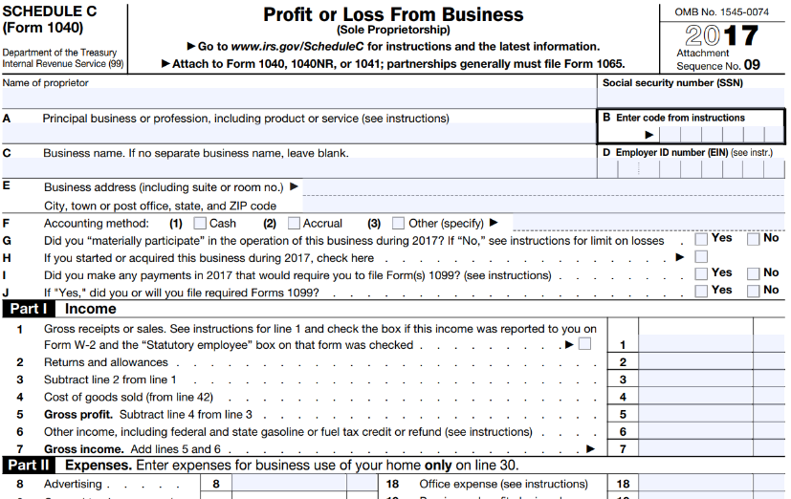
“Schedule C”
https://www.irs.gov/pub/irs-pdf/f1040sc.pdf

Slide 6

Partnership
Partnership is much like a sole proprietor, just with more than one person
B&K’s Discount Widgets

Slide 7
Partnership
A partnership has roughly the same advantages and disadvantages as a sole proprietorship.

Slide 8
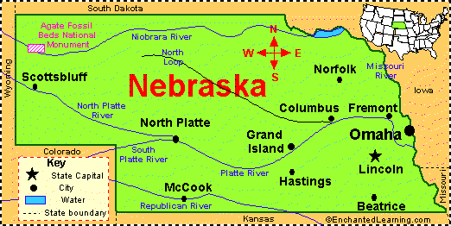
Bob’s Discount Widgets
Success!
Open more stores!
How do I proceed?
I need financing

Slide 9
Decision to incorporate
At some point, it becomes difficult for sole proprietors to raise money because of:
Unlimited liability
Limited life
To continue to grow, most companies have to incorporate
“A corporation is a distinct, permanent legal entity”

Slide 10
Corporation
Advantages:
Unlimited life
Easy transfer of ownership
Limited liability
Ease of raising capital
Disadvantages:
Double taxation (except for S-Corp)
Cost of set-up and report filing

Slide 11
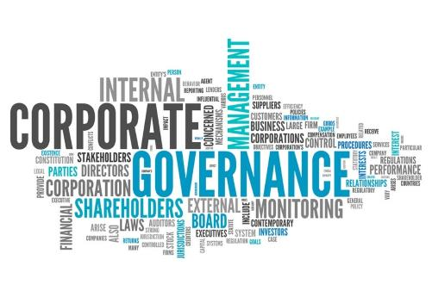
Corporate Governance
Important topic within finance
It’s the process by which corporations are controlled and directed
Attempts to solve agency problems

Slide 12
Agency Problems within Corporations
Stockholder-manager conflicts
Manager wants to use company jet for personal vacation; shareholders do not want to pay for this.
Manager doesn’t want to fire inept friends at company; shareholders want dead wood gone.
Stockholder-debtholder conflicts
Debtholders are guaranteed a modest return – if company doesn’t go bankrupt
Stockholders get what is left over
Stockholders have incentive to “roll the dice” and take excessive risks. This conflict is more severe for companies with more debt (since the equity value is basically zero anyway)

Slide 13
Agency issues: Management vs Shareholders
Shareholders demand good stock performance
Management may want to:
use corporate jets for private purposes
not work very hard
One common method of aligning the incentives of managers and shareholders is the use of stock options.
What is a stock option?
How do they work?

Slide 14
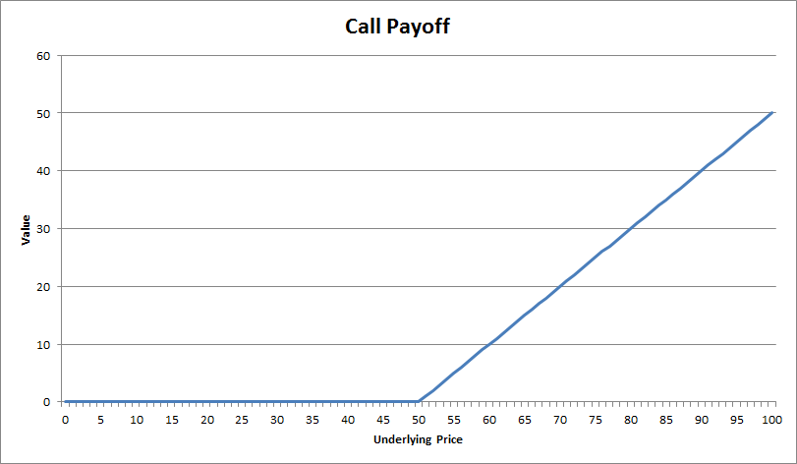
What is a call option on a stock?
Ability (not obligation) to purchase a stock at a given price (“the strike price”) and time.
The below call option has a strike price of $50.
The call option is worthless at stock prices below $50.

Slide 15
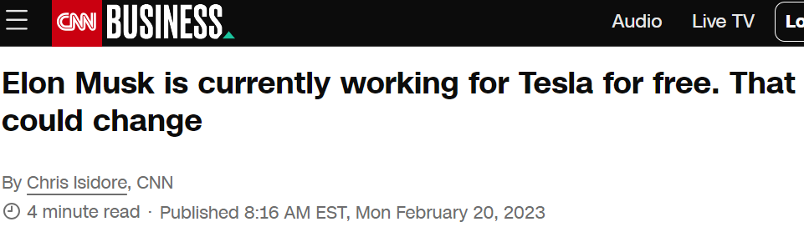
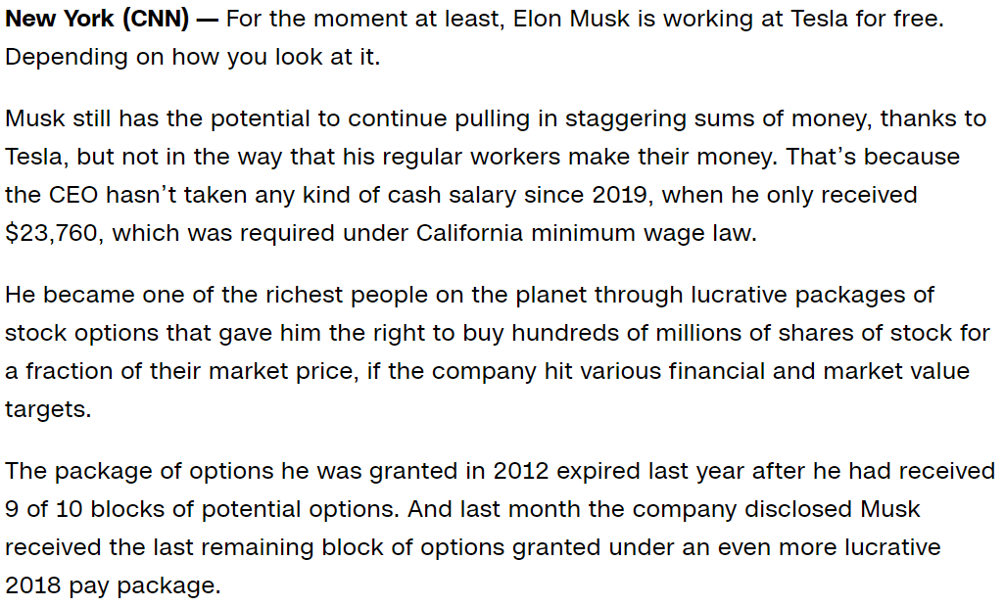
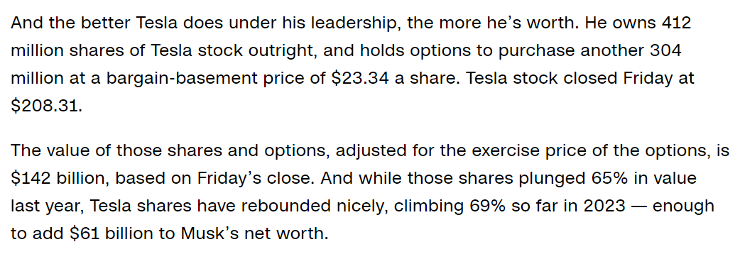

Slide 16
What is a call option on a stock?
Options formulas:
S_{T} is the stock price at expiration of the option.
K is the strike price.
You can ignore everything not highlighted in above table.

Slide 17
Agency issues: Debtholders vs Shareholders
Debtholders usually get fixed return on debt
Equity holders get what’s left over; “residual claimants”

Slide 18
Agency issues: Debtholders vs Shareholders
Assume a firm is funded with $50M of debt with a 5% interest rate + $50M of equity. The firm takes the $100M of funding and invests in one of two projects (each have duration of one year):
Project A has a guaranteed return of 7% (leaving firm worth $107M)
Project B has a 50% chance of failure (leaving firm worthless) and a 50% chance of a 100% return (leaving firm worth $200M)
What is the projected value of debt & equity for Project A?
What is the expected (average) projected value of debt & equity for Project B?

Slide 19
Project A
Project A has a guaranteed return of 7% (leaving firm worth $107M)
Debt holders get 5% return on their $50M. Equity holders get what’s left over.
Value of Debt after 1Y = $50M*(1.05) = $52.5M.
Value of Equity = $107M - $52.5M = $54.5M.

Slide 20
Project B
Project B has a 50% chance of failure (leaving firm worthless) and a 50% chance of a 100% return (leaving firm worth $200M)
50% chance of success (firm worth $200M):
Debt holders get $52.5M as before.
Equity holders get $147.5M.
50% chance of failure (firm worth $0):
Debt & equity holders get $0.
Expected (average) value of Project B:
Debt holders: $26.25M
Equity holders: $73.25M

Slide 21
Agency issues: Debtholders vs Shareholders
Since the expected value of Project B ($73.25M) is greater than the expected value of Project A ($54.5M), shareholders prefer Project B.
Debt holders prefer Project A.
Big picture takeaways:
Structure of equity (residual claimant) creates incentives for the firm to take on risk
Debt holders limit the risk of the firm through covenants

Slide 22
Debt covenants
http://www.investinganswers.com/financial-dictionary/bonds/covenant-1041
Financial covenants are frequently ratios that the borrower is required to stay above or below (a 2:1 debt-to-equity ratio or interest coverage ratio, for example), but there are usually also restrictions on debt levels and minimum working capital requirements. Financial covenants often limit the borrower's purchase of new assets, changes in control, the use of the borrowed funds, and the payment of dividends (so that shareholders cannot vote to pay themselves huge dividends, leaving nothing for the creditors). Some may also limit compensation packages for officers.

Slide 23
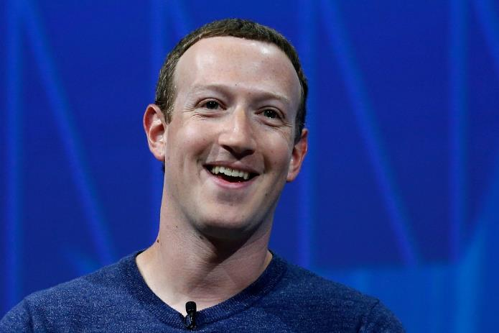
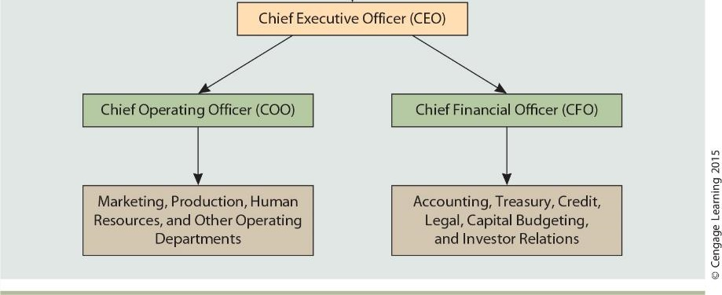
Corporate Org Chart

Slide 24
Who is Mark Zuckerberg's boss?

Slide 25
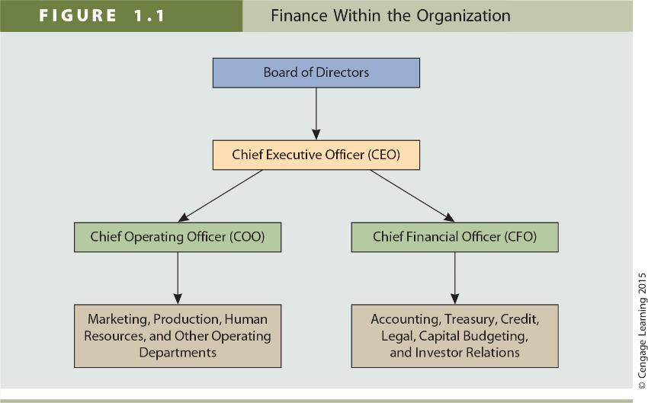
Expanded Org Chart

Slide 26

The board of directors acts on behalf of shareholders.
What does the board require of Mark Zuckerberg?
Increase profits?
Increase dividends?
Protect the environment?
Provide stable jobs to employees?

Slide 27
Who is the boss of the board?
https://en.wikipedia.org/wiki/Board_of_directors#Election_and_removal
Election and removal
In most legal systems, the appointment and removal of directors is voted upon by the shareholders in general meeting or through a proxy statement. For publicly traded companies

Slide 28
Goals of the Corporation
The primary goal is shareholder wealth maximization, which translates to maximizing long-term stock price.
This is not quite the same as maximizing profits
Accounting tricks can maximize short-term stock price with long-term reputational consequences.

Slide 29
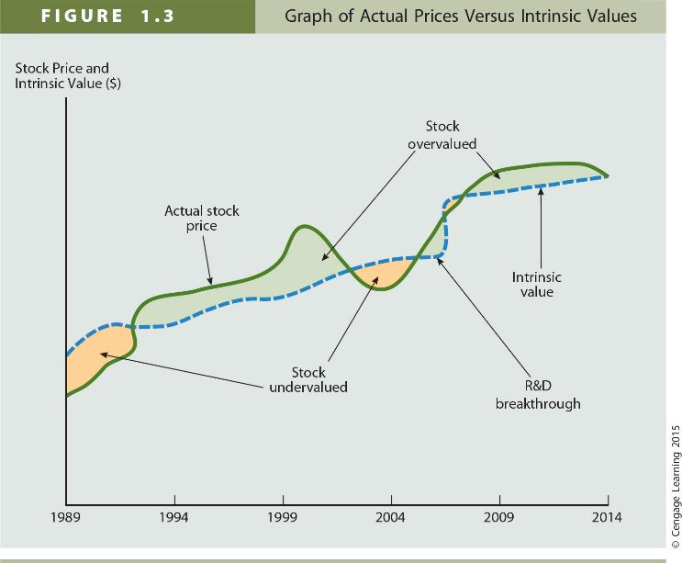
Actual vs “Intrinsic” Value

Slide 30
Factors that Affect Stock Price
Projected cash flows to shareholders
Timing of the cash flows
Riskiness of the cash flows

Slide 31
Does short-term profit maximization equal stock price maximization?
Not necessarily. Today’s stock price relies not only on current earnings, but future earnings and cash flows.
Some actions may increase short-term earnings, yet cause stock price to decrease (and vice versa).

Slide 32

The investment trade-off
Bob is asking you to invest in his business
Why?
He needs cash to expand/continue
You will invest in Bob’s business only if you can get your money back plus interest
Suppose you can earn 4% by putting your money at the bank
How much interest would Bob have to promise you?
How does this compare to the 4% rate of interest that the bank is paying?

Slide 33
Cost of Capital
The cost of capital for a business is the return investors demand to lend their money to the firm
The cost of capital depends on how risky the company is relative to other investment opportunities
Higher risk requires higher return

Slide 34

Cost of Capital
Example
Which would have a higher cost of capital? Why?
Bob’s Discount Widgets
Facebook

Slide 35
Cost of Capital
Firms should only invest in opportunities that provide a return of at least their cost of capital
Otherwise, investors would rather keep the money and invest in something else

Slide 36
Investment trade-off
Example:
The cost of capital for BDW, Inc. is 15%
BDW had profits of $250,000 last year
What should the firm do with the profits?
If the firm has investment opportunities that can earn 15% or more, BDW should reinvest the $250k back into the business
Otherwise, BDW should return the profits to the shareholders

Slide 37
The Investment trade-off
In a profitable business, the firm has to decide what to do with the profits
A. Give the money to the shareholders
B. Reinvest the funds in the business
As long as the firm can generate returns at or above shareholder expectations, then they should reinvest the funds
If they cannot generate a sufficient return, they should return the money to the shareholders

Slide 38
Goals of the Corporation
The primary goal is shareholder wealth maximization, which translates to maximizing stock price.
Should firms behave ethically?
Do firms have any responsibilities to society at large?
Is stock price maximization good or bad for society?

Slide 39
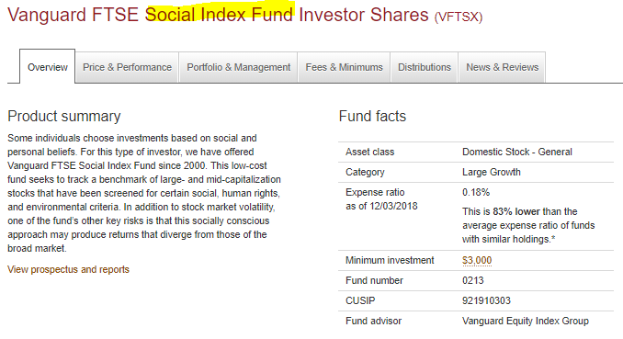
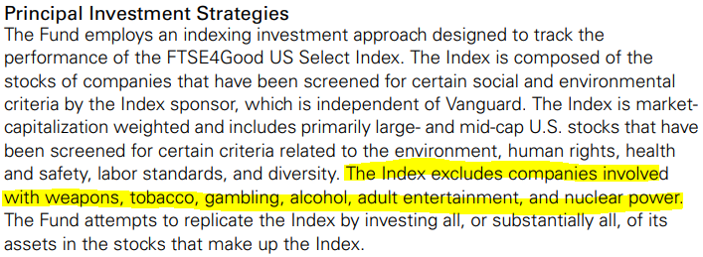
Socially Responsible Investing

Slide 40
Chapter 2
Financial Markets & Institutions

Slide 41
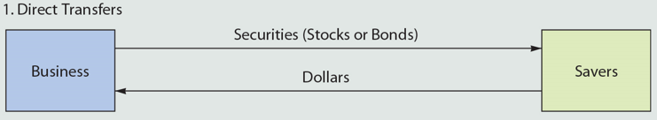
What is the point of financial markets?
Efficient allocation of capital
Matching savers & borrowers
Allocating to most productive use of $
Savers
(individuals, firms, gov’ts)
$
Borrowers
(individuals, firms, gov’ts)
$ + interest

Slide 42
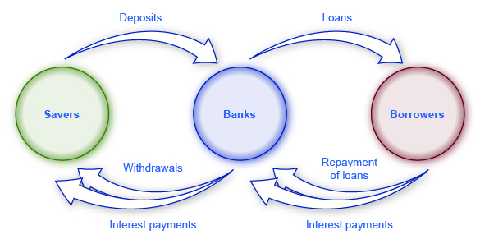
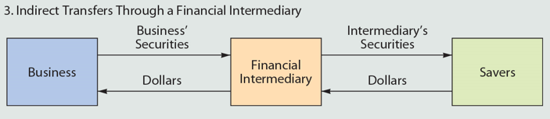
Financial Intermediation
I recently borrowed $320k (@2.875%) to purchase my first home.
Without banks, borrowing $320k from a single individual would have been difficult/impossible.
Banks serve as “intermediaries” and help savers to reduce risk through diversification.

Slide 43
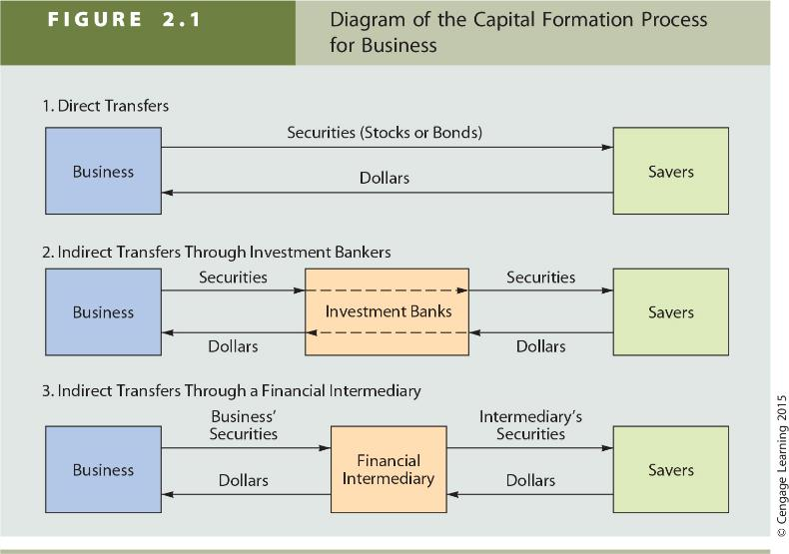
Other examples

Slide 44



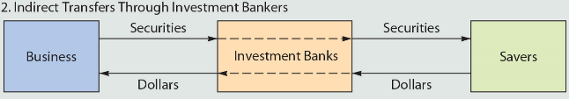
Initial Public Offering (IPO) Process
A firm “goes public” through an IPO
Shares
Shares
Public
Usually, Goldman and BDW will agree on the IPO price. For example, $20 per share.
Goldman will then buy the shares from BDW and take the responsibility for selling them to the public. So the IPO price is usually at least a little lower than the bank’s estimate of their value.
BDW pays Goldman a fee for their services, usually 7% of the total.

Slide 45
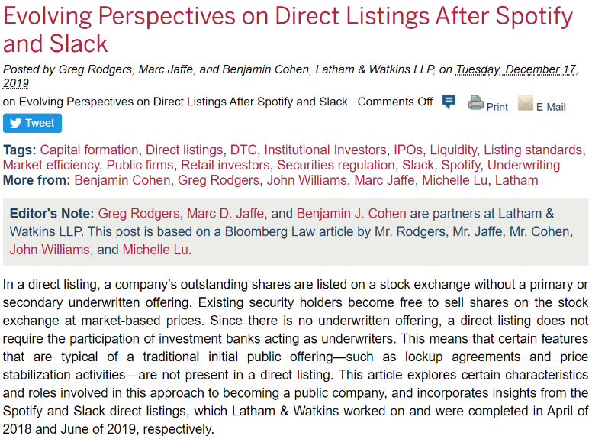
However, the IPO landscape is changing…
https://corpgov.law.harvard.edu/2019/12/17/evolving-perspectives-on-direct-listings-after-spotify-and-slack/

Slide 46
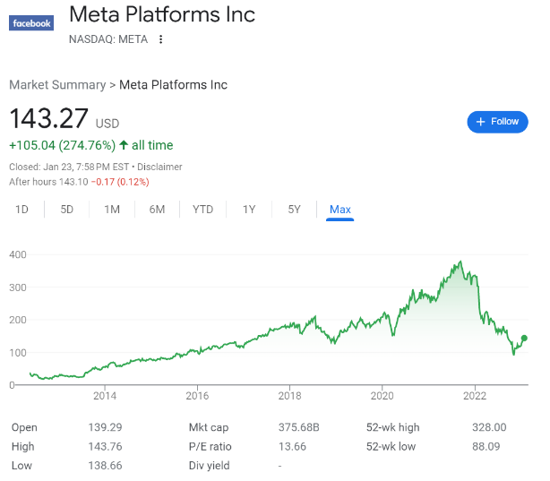
When I purchase Facebook stock, who gets the money?

Slide 47
Primary vs Secondary Markets
Primary Market:
Creation of new shares and selling to public
Initial Public Offering (IPO)
Seasoned Equity Offering (SEO)
Similar to IPO but firm is already public
Secondary Market:
Bob buys from Jill who bought from Jack
A way of transferring wealth from individual to individual

Slide 48
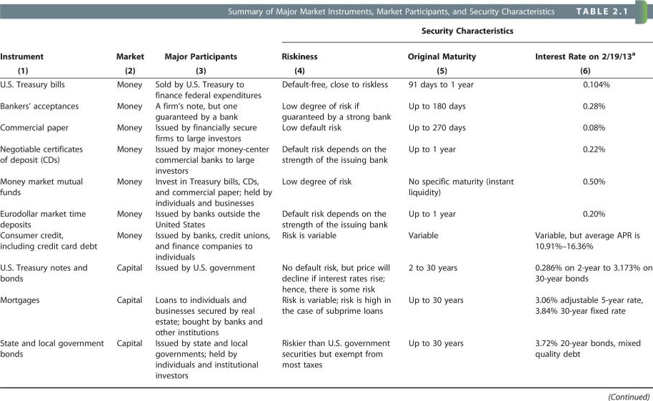
Risk vs Reward

Slide 49
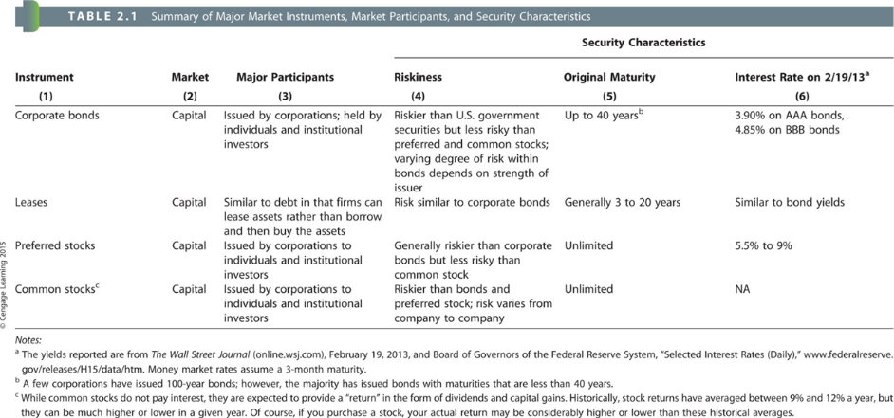
Risk vs Reward

Slide 50
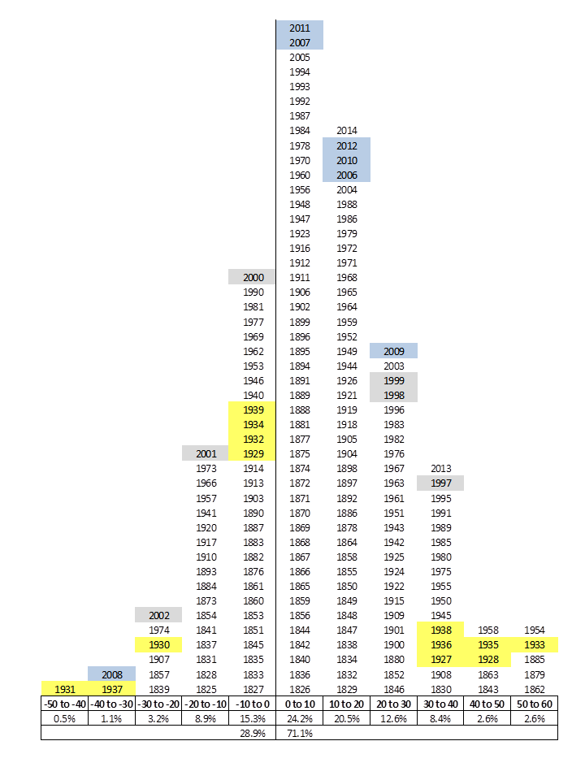
A History of Stock Market Returns Are stocks risky?

Slide 51

How are market cap and P/E ratio computed?

